Slide 1
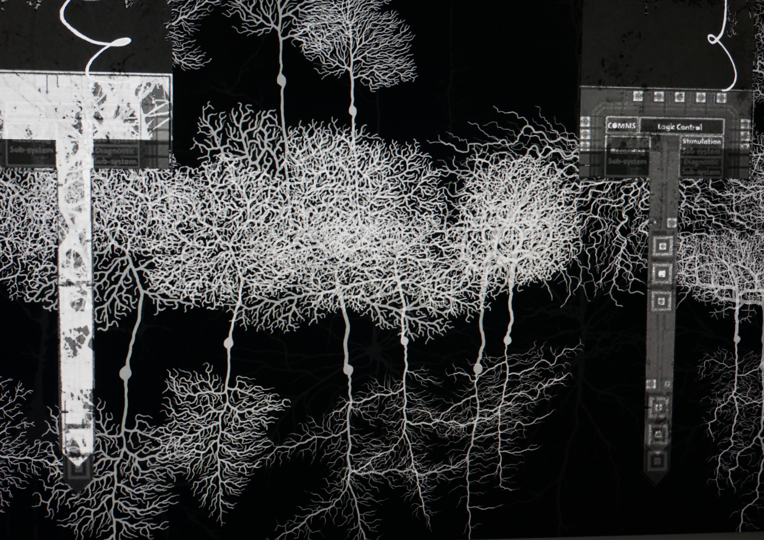
DEEP MIND
STUDENT TASKS

Slide 2
TIME or safety? The importance of independent decisions
In the film, Bella accuses Matt of persuading their terminally ill colleague Paul to test the Apogee implant before it is ready for human trials.
Before any in-human trials, a wide range of preclinical tests must be done to provide data that something works and is safe.
This data is reviewed by independent bodies who must give approval before any human testing takes place.
If Matt and Paul ignored these bodies then what they did would be illegal.

Slide 3
Key Points for discussion
Why was this such a contentious issue between Bella and Matt?
What information might human testing add that other types of testing such as cell samples and computer modelling can’t?
What are the ethical issues surrounding this decision and how might this affect the use of any data obtained?
Notes:
1. What Matt proposed was illegal. It put at risk Paul’s safety, made any data collected unreliable and if it had come to light would have caused significant damage to PNN through financial penalties and reputational damage, if not worse.
2. Testing in cell samples, animals or using computer programmes provide valuable information on how drugs and devices work and how biological systems react to them. However, they will never match the environment of the human body. This is due to the complexity of the human body and is especially relevant with the brain. Until something is tried in a human body, scientists can never be 100% sure how a therapy will interact with the body. Unfortunately there are examples of new treatments in the history of clinical trials where the human body has reacted differently than expected (for example see Northwick Park).
3. Informed consent is a vital concept of clinical trials. With Paul coping with a terminal illness and on a range of medication, he might not be capable of providing this informed consent. He also has a vested interest in the product meaning that he may not accurately report side effects or might over report any benefits, even if this is not done consciously. It may also be possible for his condition to affect the functioning of the device meaning that any data cannot be generalised. As any data generated is illegal, it cannot be published meaning that it cannot be independently verified.

Slide 4
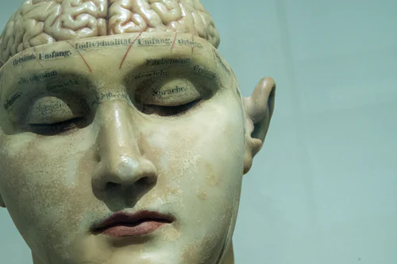
TASK
In pairs, develop a scene between Matt and Paul as they discuss trialling the Apogee prototype device in Paul.
Consider who is telling the correct story.
Did Matt push Paul into the decision?
Or was Matt an unwilling assistant?
End the scene with both men agreeing to go ahead with the trial.

Slide 5
Medicine for some or all?
At the end of the film, Bella is about to go and talk to the Board to explain what she has done to Apogee.
This has been in response to Matt’s actions in allowing a private venture capitalist group access to data about the device.
Bella felt that this was against the companies core tenet that Apogee should be for everyone.

Slide 6
Key points for discussion
How might a takeover by private funders affect the future development of Apogee?
As a device that collects information from the brain, how important is it that data collected by the device is not allowed to be exploited for commercial gain?
What is the likely reaction of the Board?
Notes:
1. Private funders will want to maximise their investment and are likely to push for ways to maximise profit. This may include the use of the technology in non-healthcare areas. They may also push to maximise costs, potentially depriving access to the poor. It may also lead to the suppressed exploration of avenues that may be more useful to people but less profitable to investors.
2. Data from the brain may potentially provide multiple avenues, even if it does not become possible to translate signals into thoughts and memories. Data is big business. Health data is especially so for insurance companies and healthcare systems. Advertising companies may want to use it to target their adverts towards specific groups. There are also questions about ownership of data and legal implications. It could even be exploited for the abuse of human rights.
3. Angry and negative. Members of the board will have invested time and money in PNN. That will now have been lost without any consultation with them.

Slide 7
TASK
Write a speech for Bella to give to the Board.
The speech should be precise and to the point, whilst providing an explanation and justification for the decision that has been taken.
It should be no longer than 5 minutes.

Slide 8
The privatisation of healthcare
It could be argued that the ideology behind PNN and Bella is to the left of the political spectrum, putting the benefit of everyone before potential profits.
Matt’s decision to engage with BlackRock, however, is driven by PNN needing to exist in a right leaning, open market world.
He believes for Apogee to succeed, PNN must accept the world they live in and not the one they might wish to live in.

Slide 9
Key points for discussion
What is the difference between the political left and right?
Apogee had been developed to benefit everyone but ends up benefitting no one. If something can’t benefit everyone, is it not better for some to benefit than deprive everyone?
Bella worries about the technology being used in other areas such as the military. If technology can benefit people in other areas, is there an ethical obligation to do so?
The collection and analysis of data can lead to improvements. But are companies and governments capable of safely storing and managing such databases?
Notes:
Left – production of goods and services is either partially or fully regulated by the government. Primary concern is an equitable distribution of wealth.
Right – relies on free market conditions for the creation of wealth. Production is based on supply and demand with efficiency having priority over equality.
PNN want equal access to Apogee, through the national health service
2. If Apogee continued then some will benefit however these are likely to be the weathy who already have access to better healthcare than others. Apogee may lead to further health inequality, detrimentally affecting the less well off.
3. Capitalism will see the use of technology in those areas which are profitable to do so regardless of what is ethically right. An issue may be whether the technology is adapted for non-health based reasons.
4. There are a number of different accounts of data breaches associated with large databases. Some of these are due to carelessness by a company, others are due to malicious attacks by hackers. How those databases are utilised is another issue. It may be used to identify trends that can improve health and healthcare.. It may also be possible to use the data for other reasons that do not benefit the people whose data it is but does benefit the companies and governments who collect the data.

Slide 10
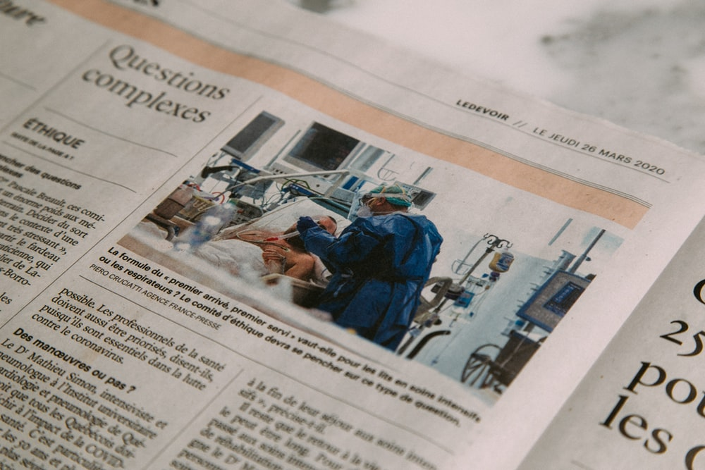
TASK
Write a newspaper article responding to the launch of Apogee and the subsequent destruction of data by Sparta.
This does not necessarily have to correspond with your own view.
For example you could choose to write it from a pro-left or pro-right point of view.

Slide 11
Lessons from medical device scandals
During the film there are various references to the Lansing ruling.
The Lansing ruling relates to another implant that was rushed out to clinical trial before it was ready.
In the real world, a number of medical devices have been withdrawn following reports of serious defects and side effects, eg breast implants.

Slide 12
Key points for discussion
What is the role of regulation in the development of medical drugs and devices?
Many problems or side effects from medical devices are only detected after long term use. However, long term testing would delay therapies from reaching patients. Where should the balance point lie?
How might an increase in regulation and testing requirements impact on a smaller development company?
Notes:
Regulation is put in place by governments in order to protect the rights and welfare of participants and the safety and benefit of the population. It looks to ensure that products that are introduced to the market are safe and efficacious due to sound, reliable research.
To try and balance this decision, regulatory authorities have a number of requirements for products that have been approved including post-marketing studies that require companies to continue to collect safety and efficacy data after approval. The MHRA also have an early warning system called the yellow card scheme that allows anybody to report side effects. Through these schemes, issues can hopefully be identified early allowing action to take place if necessary.
Conducting clinical trials is a costly business both in terms of time and money. For a small company, additional testing requirements may make a product too risky or unprofitable meaning potentially beneficial products do not reach the market. Regulations are intended to ensure products are safe and efficacious while also making the market viable for companies.
It should be noted that the medical device and pharmaceutical industry have a large lobbying group to try and influence governments to legislate in their favour.

Slide 13
TASK
Investigate a medical implant that has been in the news due to failures in the device. For example breast implants, metal on metal hips and spinal implants.
Write an essay about the scandal. Look at issues such as:
Why did the devices fail?
How were they tested?
Are they still approved?
As a starting point, explore the series of reports produced by the Guardian newspaper in 2018 called The Implant Files.

